Slide 1
Lift and shift
Notes:
Information in this document, including URL and other Internet Web site references, is subject to change without notice. Unless otherwise noted, the example companies, organizations, products, domain names, e-mail addresses, logos, people, places, and events depicted herein are fictitious, and no association with any real company, organization, product, domain name, e-mail address, logo, person, place or event is intended or should be inferred. Complying with all applicable copyright laws is the responsibility of the user. Without limiting the rights under copyright, no part of this document may be reproduced, stored in or introduced into a retrieval system, or transmitted in any form or by any means (electronic, mechanical, photocopying, recording, or otherwise), or for any purpose, without the express written permission of Microsoft Corporation.
Microsoft may have patents, patent applications, trademarks, copyrights, or other intellectual property rights covering subject matter in this document. Except as expressly provided in any written license agreement from Microsoft, the furnishing of this document does not give you any license to these patents, trademarks, copyrights, or other intellectual property.
The names of manufacturers, products, or URLs are provided for informational purposes only and Microsoft makes no representations and warranties, either expressed, implied, or statutory, regarding these manufacturers or the use of the products with any Microsoft technologies. The inclusion of a manufacturer or product does not imply endorsement of Microsoft of the manufacturer or product. Links may be provided to third party sites. Such sites are not under the control of Microsoft and Microsoft is not responsible for the contents of any linked site or any link contained in a linked site, or any changes or updates to such sites. Microsoft is not responsible for webcasting or any other form of transmission received from any linked site. Microsoft is providing these links to you only as a convenience, and the inclusion of any link does not imply endorsement of Microsoft of the site or the products contained therein.
© 2017 Microsoft Corporation. All rights reserved.
Microsoft and the trademarks listed at https://www.microsoft.com/en-us/legal/intellectualproperty/Trademarks/Usage/General.aspx are trademarks of the Microsoft group of companies. All other trademarks are property of their respective owners.

Slide 2
Abstract and learning objectives
Abstract
Students will help a global publisher architect a solution to migrate their on-premises procurement system into Azure. Because of the desire to not change the existing application, this will involve moving the application and its dependencies onto Azure IaaS VMs. There are many questions and concerns the customer has, and they will look to the student to answer these and provide the end-state design and the high-level steps to get there.
Learning objectives
Attendees will be better able to migrate and enable easy deployment for lift and shift capabilities. In addition attendees will learn to:
Build and deploy complex infrastructure solutions with Azure Resource Manager templates
Work with Azure Automation Desired State Configuration (DSC) for deploying server configurations
Scale existing templatized deployments leveraging VM Scale Sets

Slide 3
Step 1: Review the customer case study
Outcome
Analyze your customer needs
Timeframe
15 minutes

Slide 4
Customer situation
Lucerne Publishing is one of the largest English- language publishers in the world, and with nearly 200 years of history, Lucerne has published some of the world’s foremost authors
Consistently at the forefront of innovation with digital technology
Headquarters is in New York City with publishing groups in the United States, United Kingdom, Canada, Australia, and New Zealand
Notes:
Lucerne Publishing is one of the largest English- language publishers in the world, and with nearly 200 years of history, Lucerne has published some of the world’s foremost authors
Lucerne is consistently at the forefront of innovation, using digital technology to create unique reading and viewing experiences and expand the reach of its authors and documentary producers
Lucerne is headquartered in New York City and has publishing groups in the United States, United Kingdom, Canada, Australia, and New Zealand

Slide 5
Customer situation
Starting a three-year project to move the majority of its data center footprint to the cloud
Already completed a successful implementation of Office 365 with Azure AD integration.
Want to pilot a relatively high-impact workload directly in Microsoft Azure.
“We are convinced that cloud implementations will give us cost savings and, more importantly, deliver operational flexibility,” says Greg Vernon, Head of Infrastructure and Enterprise Operations
Notes:
Lucerne is starting a three-year project to move the majority of its data center footprint to the cloud
“We are convinced that cloud implementations will give us cost savings and, more importantly, deliver operational flexibility,” says Greg Vernon, Head of Infrastructure and Enterprise Operations
Lucerne has already enabled a successful implementation of Office 365 where it used Microsoft Azure Active Directory (AD) Connect to synchronize its on-premises identities to the cloud
Lucerne wants to pilot a relatively high-impact workload directly in Microsoft Azure. The workload is a third-party procurement system that is hosted on-premises today and Lucerne would like to migrate it to Azure with minimal changes

Slide 6
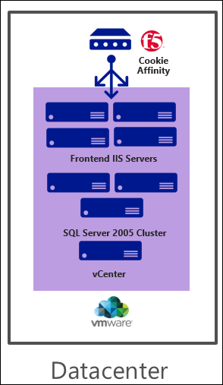
Customer situation
Third-party app deployed on four Windows 2008 R2 Microsoft Internet Information Services (IIS) VMWare VMs that are managed by vCenter
ASP.NET with .NET 3.5
App deployed via a wizard to install assemblies into the global assembly cache (GAC)
IIS hardware: 2 vCPUs Xeon processors and 6 GB of memory on each server
F5 with cookie affinity for session state support
Backend SQL 2005/Failover Cluster (app is compatible with SQL Server 2016)
App uses distributed queries, heavy use of TempDB, and SQL Server Reporting Services (SSRS), and has a maximum database size of just 200 GB
SQL hardware: 8 vCPUs Xeon processors and 16 GB of memory on each server
Notes:
Let us elaborate on the procurement system that is in place

Slide 7
Customer needs
How can we assess our environment for suitability and cost analysis before migrating to Azure?
Network connectivity requirements
Isolated privileges for resources in Azure
Migration options for the web tier
Notes:
How can we assess our environment for suitability and cost analysis before migrating to Azure?
Identify the infrastructure requirements and plan for establishing a connection with Azure ExpressRoute that will support Lucerne’s migrated infrastructure.
Isolate privileges for managing infrastructure in the cloud as well as understand what governance controls can be put in place to control costs and supported workloads. Ensure that workloads deployed to Azure cannot be deleted or changed without authorization or by accident.
Document the options for migrating the web tier to Azure keeping in mind that the configuration of the application will essentially be the same (supporting cookie affinity, etc.).

Slide 8
Customer needs
Create a migration plan for the database tier and ensure that the database will always be available even if a VM fails or during normal maintenance.
Understand how backup for this workload will work after migration.
The migration should be fully testable prior to switchover.
The migration should fall within a 12 hour window or less.
Notes:
Create a migration plan for the database tier and ensure that the database will always be available even if a VM fails or during normal maintenance, such as patching monthly or when service packs are applied to the SQL Servers.
Understand how backup for this workload will work after migration (for application and compute workloads).
Prior to the migration, the procurement team should be able to perform a full test of the application running in Azure to ensure that it is fully functional.
The migration needs to be completed as quickly as possible, but it does not have to be immediate. The customer can stand for a 12-hour outage window in which the system can be down for this one time move to the Cloud. Lucerne demands that there is a way to “fail back” if something goes wrong or they are outside of that 12-hour window.

Slide 9
Customer objections
How can we tell how much we will really be spending once we have migrated to Azure?
Moving procurement to the cloud seems like a security problem. It should only be accessible from people at Lucerne’s offices.
We already have licenses for SQL Server. We do not want to pay for them again.
Notes:
The customer’s objections include the following:

Slide 10
Customer objections
The procurement application is a simple application with known dependencies and is perfect for a pilot. What about more complicated workloads or workloads where we do not exactly know where the dependencies are?
The sun never sets on Lucerne Publishing. Logistics and procurement is one of our most critical applications. Any glitch will cause havoc in our ecosystem. The system can be down for only 12 hours during this one time move. How will you ensure that our migration to Azure will happen as quickly and seamlessly as possible?
Notes:
The customer’s objections include the following:

Slide 11







Common scenarios
Azure Infrastructure as a Service (IaaS)
Azure Resource Manager
Virtual machines
Virtual networks
VPN gateway
Role Based Access Control (RBAC)
Hybrid connectivity
Load balancers
Storage
Resource Manager policies & locks
Notes:
In the following slides, we will touch on some Azure technologies that can and should be leveraged when thinking about the solution that will be designed for Lucerne Publishing. In the corresponding Case Study document, you will also find links that elaborate even further on these topics.
In this slide we call out Azure infrastructure as a service (or IaaS) components – Virtual Machines & Virtual Networking (highlighting a couple of ways to connect to the Azure cloud – by way of a Site to Site Connection or a Point to Site connection)
Azure Resource Manager is the API surface layer for managing resources in Azure. It provides two features that may come in useful:
Role Based Access Control – allows you to define who can perform what action
Resource Manager Policies – allows you to define what actions can be performed on an Azure Subscription
Locks – allows you to define policies to block accidental deletion of resources

Slide 12



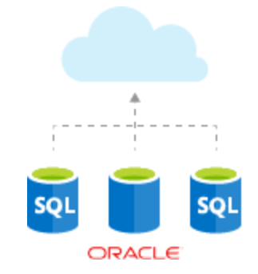

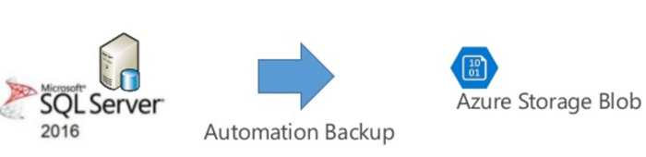
Common scenarios
Backup and business continuity
Migration tools
Azure Backup
Azure Migrate
Database Migration Service
Azure Site Recovery
SQL Server Managed Backup
Database Migration Assistant
Notes:
Some of the solutions you may consider could involve:
Azure Site Recovery – this service provides the ability to replicate virtual machines or physical servers to Microsoft Azure.
Azure Backup – this service provides several abilities including the ability to backup a VM directly, files or folders, or workload specific backup such as SQL Server, AD, HyperV and VMWare.
SQL Server Managed Backup – this feature in SQL Server allows you to use Azure Storage as a backup target
Azure Migrate – service that provides many features that may come in useful during a lift and shift migration
Azure Database Migration Service – service currently in preview that helps migrate databases to the cloud
Azure Database Migration Assistant – downloadable application that can help migrate databases to the cloud

Slide 13
Step 2: Design the solution
Outcome
Design a solution and prepare to present the solution to the target customer audience in a 15-minute chalk-talk format.
Timeframe
60 minutes
Business needs (10 minutes) | Respond to questions outlined in your guide and list the answers on a flipchart.
Design (35 minutes) | Design a solution for as many of the stated requirements as time allows. Show the solution on a flipchart.
Prepare (15 minutes) | Identify any customer needs that are not addressed with the proposed solution. Identify the benefits of your solution. Determine how you will respond to the customer’s objections. Prepare for a 15-minute presentation to the customer.

Slide 14
Step 3: Present the solution
Outcome
Prepare to present a solution to the target customer in a 15-minute chalk-talk format
Timeframe
30 minutes (15 minutes for each team to present and receive feedback)
Directions
Pair with another table
One table is the Microsoft team and the other table is the customer
The Microsoft team presents their proposed solution to the customer
The customer asks one of the objections from the list of objections in the case study
The Microsoft team responds to the objection
The customer team gives feedback to the Microsoft team

Slide 15
Wrap-up
Outcome
Identify the preferred solution for the case study
Identify solutions designed by other teams
Timeframe
15 minutes

Slide 16
Preferred target audience
Greg Vernon, Head of Infrastructure and Operations
Jesse Adams, Infrastructure Lead
Identity and security Leads
Network engineering
Procurement infrastructure team

Slide 17
Preferred solution
The solution for Lucerne Publishing’s scenario involved several technologies, including:
Deploy the application to Azure using Azure Virtual Machines
Hybrid connectivity with ExpressRoute
Role Based Access Control (RBAC)
SQL Server with bring your own licenses (BYOL), Always On and Cloud Witness
Azure Application Gateway for load balancing
Notes:
The solution for Lucerne’s scenario involved several technologies, including:
Deploy the application to Azure using Infrastructure as a Service (IaaS), Virtual Machines for both the web tier and data tier of the Procurement application
Networking team deployed a Virtual Network in Azure and connected the New York HQ to Azure via ExpressRoute configured with public and Microsoft peering
Using RBAC to control access to the networking and procurement resources separately
Built new BYOL SQL Server 2016 servers on Windows Datacenter Server 2016 with AlwaysOn Availability Groups leveraging Cloud Witness
Azure App Gateway was chosen for load balancing to address cookie session management requirements, and network security groups to lock down access to only the on-premises users

Slide 18
Networking
Establish ExpressRoute connection using private and Microsoft peering.
A simple Virtual Network design given the address space of 10.0.1.0/24 could have the following subnets:
10.0.1.0/26 Web
10.0.1.64/26 Data
10.0.1.128/28 Gateway (ExpressRoute gateways require a /28 subnet)
Use a network security group to only allow on-premises traffic to the procurement solution.
Configure the Virtual Network to reference the on-premises active directory for the pilot.
Notes:
Establish ExpressRoute connection using public and private peering
A simple Virtual Network design given the address space of 10.0.1.0/24 could have the following subnets:
10.0.1.0/26 Web
10.0.1.64/26 Data
10.0.1.128/28 Gateway (ExpressRoute gateways require a /28 subnet)
A network security group should be created to allow inbound and outbound traffic from the on-premises 172.16.0.0/16 network and between the Procurement and Database subnets in Azure to minimize the attack surface.
Configure the Virtual Network to reference the existing AD Domain Name System (DNS) Infrastructure to enable users to successfully authenticate. Deploying domain controllers in the same virtual network would be advised once the deployment moves out of the pilot phase.

Slide 19
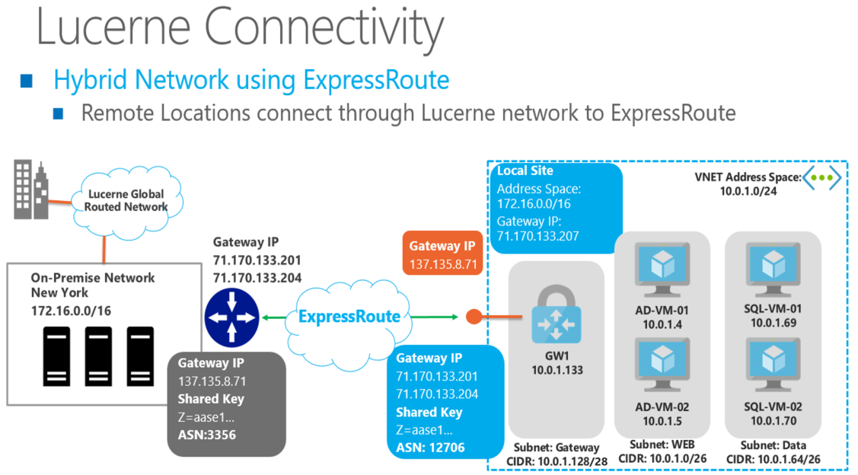
Network design

Slide 20
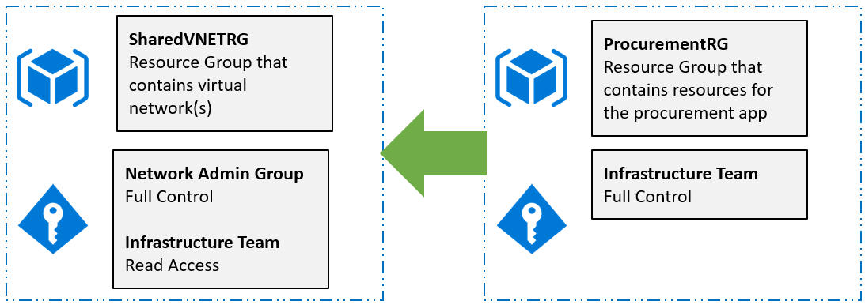
Design for limiting access to resources
Lucerne should use the same Azure AD tenant that they use for Office 365.
Deploy the Virtual Network into its own resource group. This allows them to segment out resources and assign management rights just to the team that requires them.
The procurement resources should go in a separate resource group as they all share the same life cycle and should be managed by the same team.

Slide 21
Azure Resource Manager policies and locks
ARM Policies for:
Locations resources can be created
Required tags
Naming conventions of created resources
Image types that can be created
Instance sizes for VMs
Services that can be used (service catalog)
Once the solution is in production, resource locks will be used on to ensure that no changes happen by accident.
Notes:
Using Azure Resource Manager policies Lucerne can set the following constraints to assist with governance:
Locations resources can be created
Required tags
Naming conventions of created resources
Image types that can be created
Instance sizes for VMs
Services that can be used (service catalog)
Once the solution is in production, resource locks will be used on to ensure that no changes happen by accident

Slide 22
Azure migrate
Assess Azure readiness: Assess whether your on-premises machines are suitable for running in Azure.
Get size recommendations: Get size recommendations for Azure VMs based on the performance history of on-premises VMs.
Estimate monthly costs: Get estimated costs for running on-premises machines in Azure.
Migrate with high confidence: Visualize dependencies of on-premises machines to create groups of machines that you will assess and migrate together. You can accurately view dependencies for a specific machine, or for all machines in a group.
Notes:
The Azure Migrate service can be used to assess the infrastructure in your environment. The Azure Migrate service assesses on-premises workloads for migration to Azure. The service assesses migration suitability and performance-based sizing, and provides cost estimations for running your on-premises machines in Azure.
The Azure Migration Service provides the following benefits:
Assess Azure readiness: Assess whether your on-premises machines are suitable for running in Azure.
Get size recommendations: Get size recommendations for Azure VMs based on the performance history of on-premises VMs.
Estimate monthly costs: Get estimated costs for running on-premises machines in Azure.
Migrate with high confidence: Visualize dependencies of on-premises machines to create groups of machines that you will assess and migrate together. You can accurately view dependencies for a specific machine, or for all machines in a group.

Slide 23
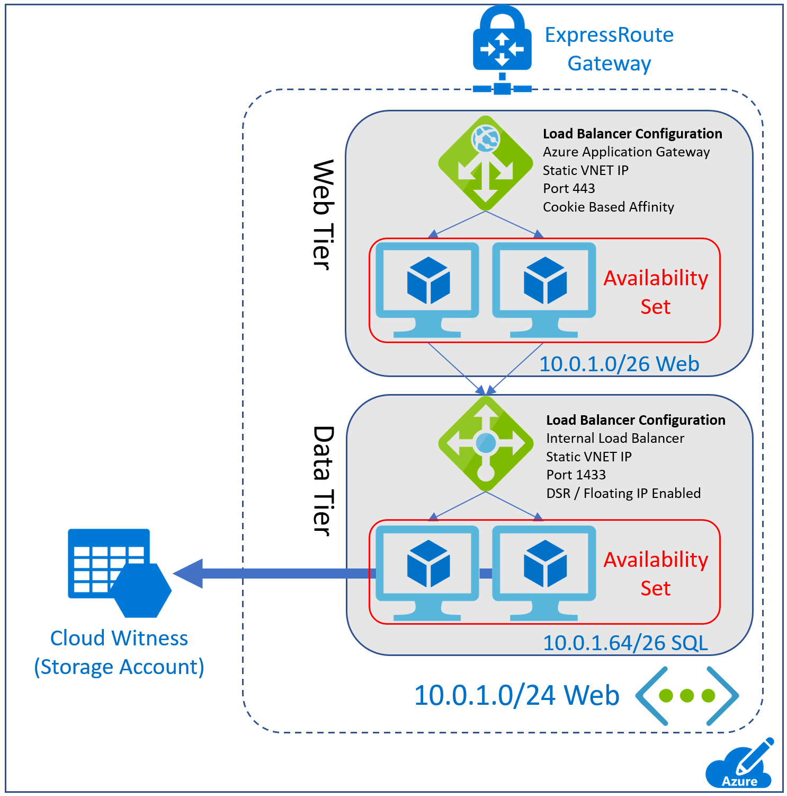
Procurement migration overview
Option 1: Migrate the IIS servers to Azure using Azure Site Recovery (ASR).
Option 2: Convert VMware VMs to Azure VMs using the Starwind V2V Converter and upload as specialized images
Option 3: Create infrastructure manually and manually reinstall Load Balancer Configuration:
Azure App Gateway with internal load-balancer (ILB) and cookie-based affinity
ILB for SQL with Direct Server Return for Always On
Web VMs: DS2_v2 in an availability set
SQL VMs: DS3_v2 in an availability set

Slide 24
Procurement migration – SQL Server
Migrate to VMs for SQL Server 2016 with Always On.
DS3_v2 instance size deployed into a Availability Set
Cloud Witness (Storage Account)
Backup:
SQL Server Managed Backup to Microsoft Azure
Or use Microsoft Azure Backup Server

Slide 25
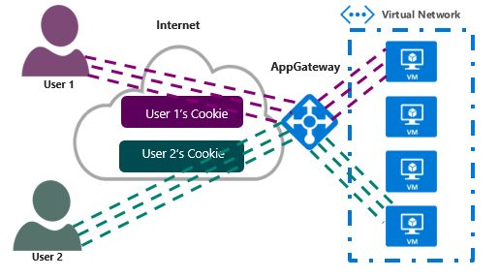
Migration steps
Create the Azure Application Gateway:
Associate the AppGateway with the web tier subnet.
Configure the frontend IP configuration with a static IP from the web tier subnet.
Configure the backend server pool of IPs to reference the procurement web servers.
Set cookie-based affinity on the backend HTTP server settings list.
Notes:
Over the next 11 slides we will talk through the migration steps that Lucerne Publishing should follow for a successful migration.

Slide 26
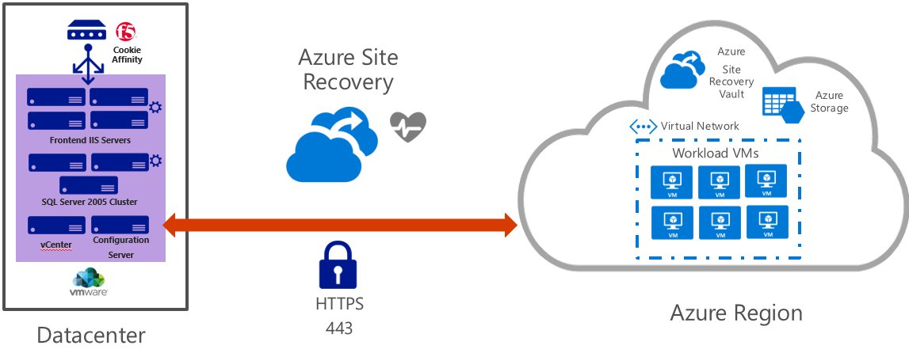
Option 1: Migration steps using ASR details
Use Azure Site Recovery to facilitate the migration.
ASR supports VMware to Azure Resource Manager failovers and will be used for the web tier of the application.
This allows for simple migration of the application that had a complex installation.

Slide 27
Option 1: ASR migration steps (continued)
Step 1: Using the Azure Portal, build a Recovery Services Vault.
Step 2: Set up the target environment by choosing the Subscription, Storage Account, and Virtual Network that will be used for the web servers when they are migrated over to Azure.
Step 3: Set up the replication settings and get the application replicating.
Step 4: Replicate the application and set the failover properties for when the web servers come online.
Step 5: Complete a Test Failover from the Azure Portal to ensure that the machines will in fact failover and start properly.
Step 6: Migration Night
To perform the migration, a planned failover will be initiated from the portal.
Once the web tier machines are up and running in Azure, the administrator should sign in and manually change the connection strings in IIS to point to the new SQL AG listener. (This could be scripted as a part of the failover as well, but since this is a one-time migration, it is not worth the effort.)
See the SQL Migration Night step for the instructions on how to back up and manually restore the data to the new SQL Server Cluster.
Step 7: Rollback (if required): The planned failover should be canceled from the portal and then the VMs in VMware should be restarted to restore service.

Slide 28
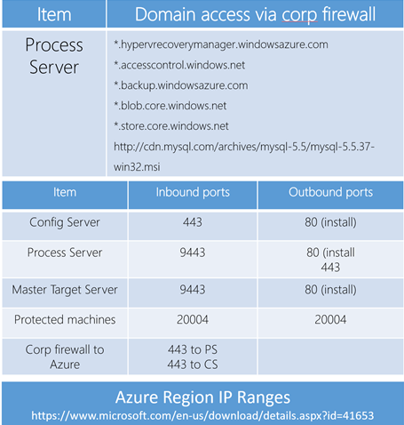
Option 1: ASR migration steps (continued)
Open these ports/sites to ensure all servers can communicate.
For Windows machines, a group policy (GPO) could be used to open the ports in the domain.
Whitelist IP ranges in the Azure region where the Site Recovery vault(s) are located
VPN or ExpressRoute connection required for failback.

Slide 29
Option 2: Virtual to virtual disk migration (V2V)
The current webservers are VMware VMs that are running on vCenter. In order to migrate this as is to Azure, Lucerne must convert the Vmware VM disks (*.vmdk) to Hyper-V (*.vhd)
Step 1: Create a storage account, virtual network, and establish site-to-site connectivity.
Step 2: Download and install Starwind V2V Converter on a local server
Step 3: Install the Azure Virtual Machine agent on servers that will be migrated, and uninstall the VMware Tools
Step 4: Stop the VMs using vCenter and then use the V2V Converter making sure to specify output of the fixed VHD format.
Step 5: Use Azure Storage Explorer or the Add-AzureRmVHD cmdlet to upload disks to a storage account.
Step 6: Use PowerShell or a template to create the VMs for the web tier from disks into an availability set.
Step 7: Create the Azure Application Gateway associated with the Procurement subnet. Configure the frontend IP configuration with a static IP from the procurement subnet. Configure the backend server pool of IPs to reference the procurement web servers. Set cookie-based affinity on the backend HTTP server settings list.
Step 8: Update DNS to map the hostname https://procurement to the static IP of the App Gateway.
Step 9: Complete the SQL Migration and update the connection strings.
Notes:
The current webservers are VMware VMs that are running on vCenter. In order to migrate this as is to Azure the Lucerne must use the Microsoft Virtual Machine Converter 3.0 PowerShell Cmdlet tools. These must be downloaded and installed on a local work station.

Slide 30
Option 3: Rebuild and redeploy for Web tier
Step 1: Create a storage account, virtual network, and establish hybrid connectivity (Customer asked for ExpressRoute).
Step 2: Update the virtual network to reference the domain controllers on-premises in DNS.
Step 3: Use the Azure portal, PowerShell or a template to create the VMs for the web tier from disks into an availability set running Windows Server 2016 Datacenter Web servers.
Step 4: Using the install wizard to manually install the application again, making sure to configure anything per the vendors instructions or restore any configurations that might be required for the application from the on-premises servers.
Step 5: Create the Azure Application Gateway associated with the Procurement subnet. Configure the frontend IP configuration with a static IP from the procurement subnet. Configure the backend server pool of IPs to reference the procurement web servers. Set cookie-based affinity on the backend HTTP server settings list.
Step 6: Update DNS to map the hostname https://procurement to the static IP of the App Gateway.
Step 7: Complete the SQL Migration and update the connection strings.

Slide 31
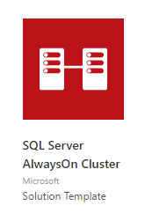
SQL Server migration steps details
SQL Server migration
Since the SQL Server is being upgraded from SQL Server 2005 to SQL Server 2016, a rebuild is required.
Step 1
Build a SQL Cluster in Azure
DS3_V2 instances, Cloud Witness in Storage, Availability Set
Step 2
Use Database Migration Assistant to migrate the data from SQL 2005 to the new SQL Server 2016 deployment
Ensure connectivity between on-premises and Azure first.
Notes:
Step 1: Build a SQL Cluster in Azure
Create a Premium Storage Account.
Using a template from the Azure Marketplace, deploy a SQL Server 2016 Always On Cluster.
Make sure to choose the correct region, Virtual Network, and subnet that are designated for database servers. Standard DS3_V2 for the SQL Servers and a dedicated storage account for the Cloud Witness.
Update the Network security groups to allow traffic between the web tier and the data tier subnets only on port 1433 from the web tier subnet. Consider other Network Security Group (NSG) rules to secure the data.
Step 2: Use Database Migration Assistant to migrate the data to the new SQL Server.
Ensure the source database is on a network that is routable over the ExpressRoute connection.
Install Database Migration Assistant locally (does not have to be on the SQL server). It does require .NET 4.5.2.
Create a migration project
Specify the project type as Migration (you can also do an assessment first to ensure the compatibility of the migration).
Specify the procurement database that is running SQL Server 2005 as the source database and the new database in Azure as the target.
Add the procurement database to the databases list.
Specify a shared location that the source and target SQL instances have access to.
Make sure that the user account running Data Migration Assistant has read privileges to the backup location and write privileges to the location from which the target server restores.
Start the migration and view the results.

Slide 32
Preferred objection handling
Objection
How can we tell how much we will really be spending once we have migrated to Azure?
Potential answer
Using the Azure Migrate service, Lucerne Publishing could monitor their existing on-premises solutions prior to migration and review the suggested virtual machine sizes and estimated cost for running the solution in Azure.

Slide 33
Preferred objection handling
Objection
The procurement application should only be accessible from people at Lucerne’s offices. Putting it in the cloud seems like a security problem.
Potential answer
Lucerne deployed Azure ExpressRoute. With ExpressRoute the connection between the on-premises network and the Azure virtual network is dedicated and private and does not traverse the public Internet at all.
Network security groups can also be used to further limit network communication. For instance, a network security group could be used to only allow the on-premises network and restrict other address spaces in the virtual network itself.

Slide 34
Preferred objection handling
Objection
We already have licenses for SQL Server. We do not want to pay for them again.
Potential answer
Creating a virtual machine using the SQL Server bring your own license (BYOL) images, now available in the Azure Marketplace, resolves this problem and the existing investments can be capitalized on.

Slide 35
Preferred objection handling
Objection
Our operations team is new to the cloud and currently uses existing technologies like SCOM. We are concerned about the time it takes to learn new technologies to monitor and maintain an existing workload.
Potential answer
Virtual machines in Azure are not that different from virtual machines in Hyper-V. With hybrid connectivity, SCOM could be used to manage the cloud-based deployment in the same way as they are today.

Slide 36
Preferred objection handling
Objection
The sun never sets on Lucerne Publishing. Logistics and procurement is one of our most critical applications. Any glitch will cause havoc in our ecosystem. The migration process cannot bring down the application for more than 12 hours. How will you ensure that our migration to Azure will happen as quickly and seamlessly as possible?
Potential answer
By using Azure Site Recovery, the process to failover is very quick and smooth. The process should be easy to do in under an hour. Also, if the application does not appear to be working or there is an unforeseen complication, the back out plan is very simple to implement.

Slide 37
Preferred objection handling
Objection
The procurement application is a simple application with known dependencies and is perfect for a pilot. What about more complicated workloads or workloads where we do not exactly know where the dependencies are?
Potential answer
Using dependency visualization from Azure Migrate, you can view the network dependencies of specific machines, or across a group of machines. This is useful in ensuring no functionality is lost (or machines forgotten) in the migration process when apps and workloads run across multiple machines.

Slide 38
Customer quote
“By using Azure, we can focus on our primary business, which is publishing, rather than on building and managing data centers, which can often be complicated, time-consuming, and expensive.”
—Greg Vernon, Head of Infrastructure and Enterprise Operations,
Lucerne Publishing
Notes:
The following quote by Greg Vernon, Head of Infrastructure and Enterprise Operations, at Lucerne Publishing summarizes the benefits of moving to the Azure cloud.
Thank you for your participation in this real-world case study.

